Slide 1
Quantifying Controversy on Social Media
Kiran Garimella,
Gianmarco De Francisci Morales, Aristides Gionis,
Michael Mathioudakis
Aalto University

Slide 2
Controversies are everywhere!

Slide 3
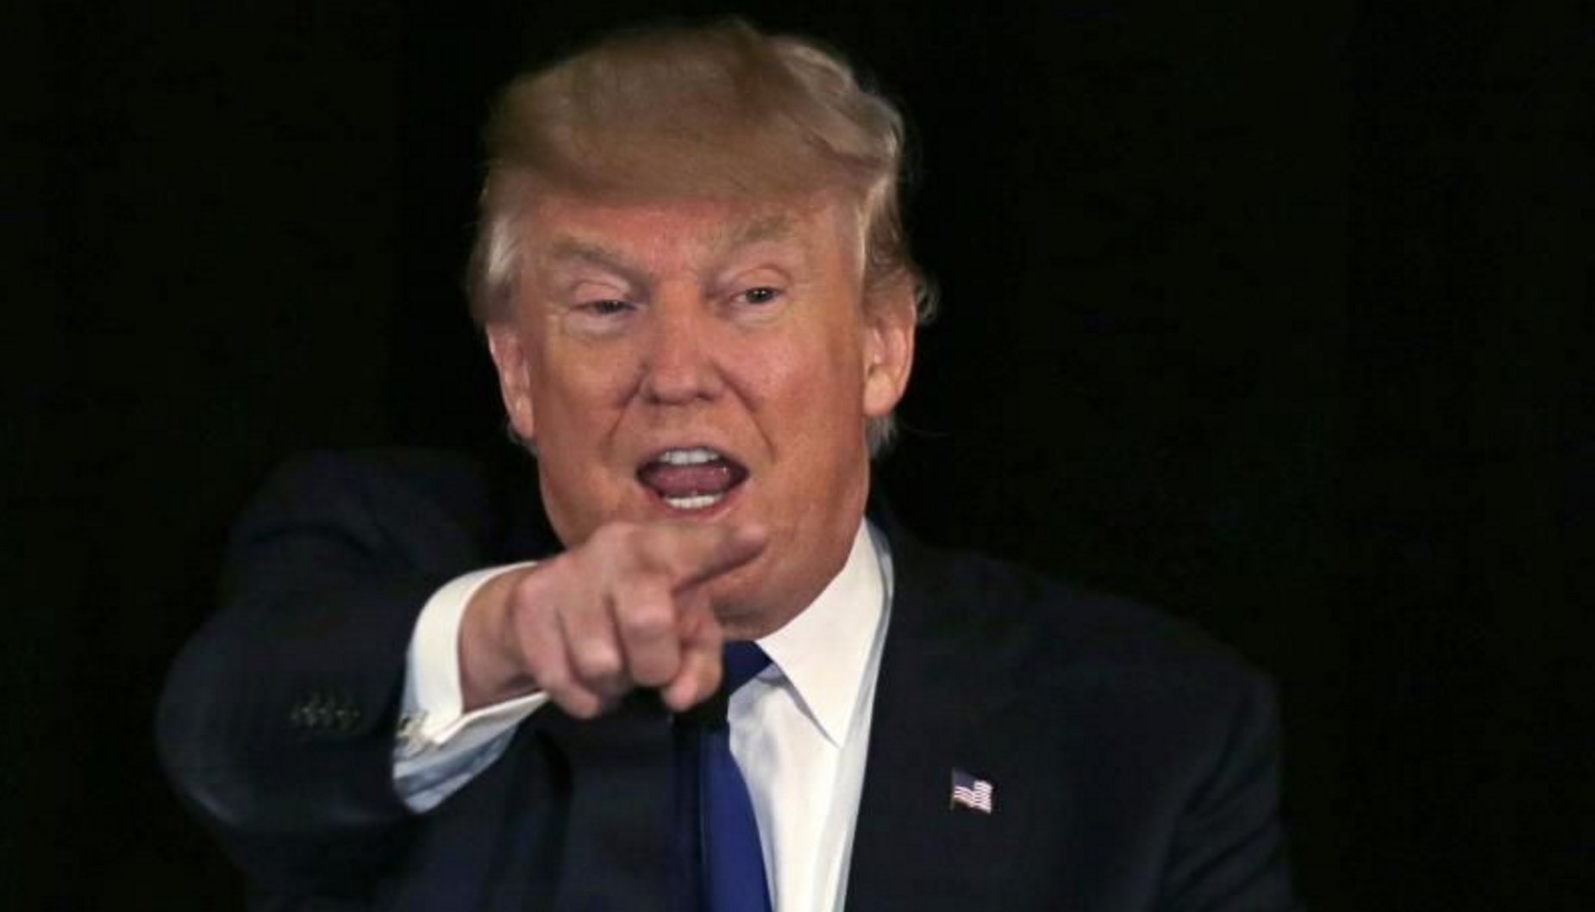

Slide 6
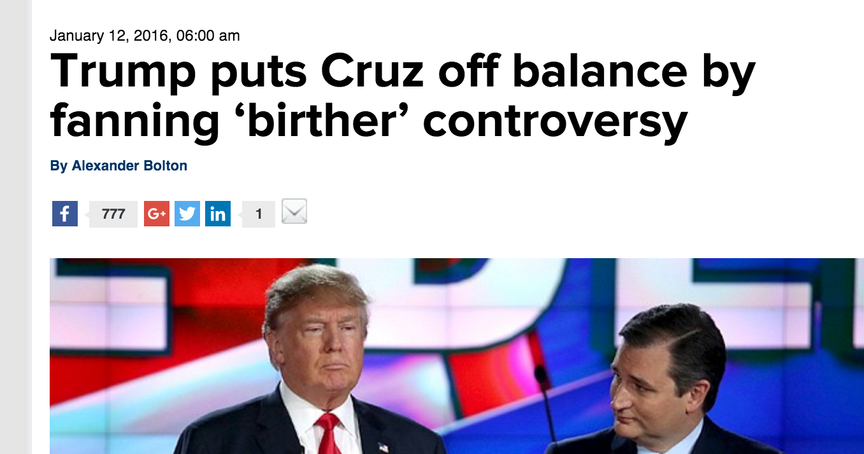

Slide 7
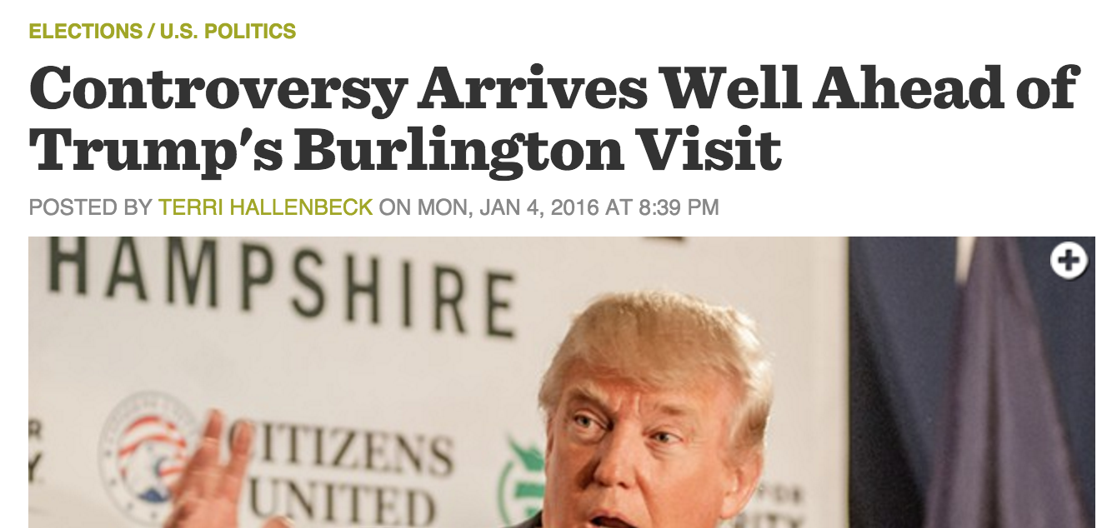

Slide 8
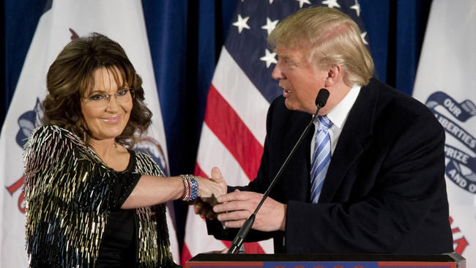
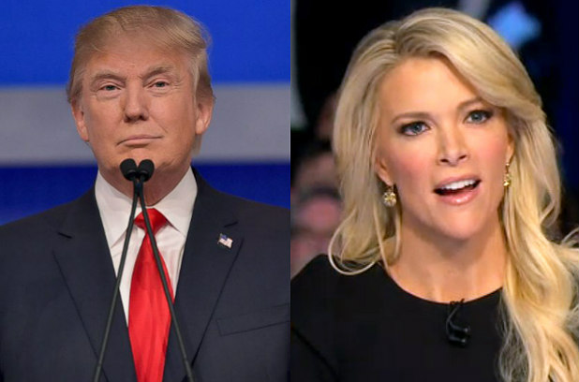
And there’s always two sides to a controversy…
VS.

Slide 9
Increasing polarization in the society

Slide 11
Motivation
Detect controversies automatically on social media

Slide 12
Motivation
Detect controversies automatically on social media
Design methods to reduce the polarization

Slide 13
Motivation
Detect controversies automatically on social media
Design methods to reduce the polarization
This paper

Slide 14
Contributions

Slide 15
Controversy in the wild

Slide 16
Controversy in the wild

Slide 17
Controversy in the wild
Not necessarily political controversies
No domain knowledge
Language independent

Slide 18
Need not be political …

Slide 20
Comparing across controversies

Slide 21
Comparing across controversies

Slide 22
Comparing across controversies

Slide 23
Solution
Graph based formulation

Slide 24
Example
retweet graphs
#beefban
#russia march
#sxsw
#germanwings.
controversial
non-controversial

Slide 25
Pipeline
Controversy score
Retweets
Mentions
Social network
Content
Any
Clustering algorithm
Random walk
Edge-betweenness
2d-embedding
Sentiment variance

Slide 26
To learn more…
Visit our poster
@gvrkiran, @gdfm7
@gionis, @mmathioudakis

